Slide 1
Trees
Based on Chapter 8,
Koffmann and Wolfgang
Chapter 8: Trees

Slide 2
Chapter Outline
How trees organize information hierarchically
Using recursion to process trees
The different ways of traversing a tree
Binary trees, Binary Search trees, and Heaps
Implementing binary trees, binary search trees, heaps
  Using linked data structures and arrays
Using binary search trees for efficient data lookup
Using Huffman trees for compact character storage
Chapter 8: Trees

Slide 3
Tree Terminology
A tree is a collection of elements (nodes)
Each node may have 0 or more successors
  (Unlike a list, which has 0 or 1 successor)
Each node has exactly one predecessor
  Except the starting / top node, called the root
Links from node to its successors are called branches
Successors of a node are called its children
Predecessor of a node is called its parent
Nodes with same parent are siblings
Nodes with no children are called leaves
Chapter 8: Trees

Slide 4
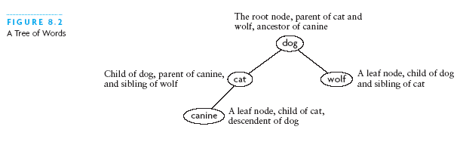
Tree Terminology (2)
We also use words like ancestor and descendent
Chapter 8: Trees

Slide 5
Tree Terminology (3)
Subtree of a node:
  A tree whose root is a child of that node
Level of a node:
  A measure of its distance from the root:
  Level of the root = 1
  Level of other nodes = 1 + level of parent
Chapter 8: Trees

Slide 6
Tree Terminology (4)
Level 1 (root)
Level 2
Level 2
Level 2
Chapter 8: Trees

Slide 7
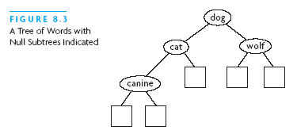
Binary Trees
Binary tree: a node has at most 2 non-empty subtrees
Set of nodes T is a binary tree if either of these is true:
  T is empty
  Root of T has two subtrees, both binary trees
  (Notice that this is a recursive definition)
This is a
binary tree
Chapter 8: Trees

Slide 8
Examples of Binary Trees
Expression tree
  Non-leaf (internal) nodes contain operators
  Leaf nodes contain operands
Huffman tree
  Represents Huffman codes for characters appearing in a file or stream
  Huffman code may use different numbers of bits to encode different characters
  ASCII or Unicode uses a fixed number of bits for each character
Chapter 8: Trees

Slide 9
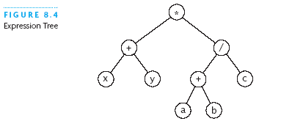
Examples of Binary Trees (2)
Chapter 8: Trees

Slide 10
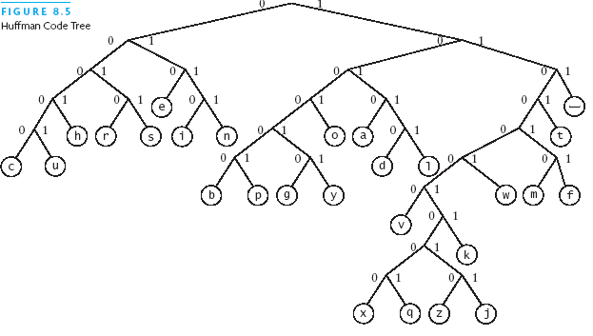
Examples of Binary Trees (3)
Code for b = 100000
Code for w = 110001
Code for s = 0011
Code for e = 010
Chapter 8: Trees

Slide 11
Examples of Binary Trees (4)
Binary search trees
  Elements in left subtree < element in subtree root
  Elements in right subtree > element in subtree root
Search algorithm:
if the tree is empty, return null
if target equals to root node’s data, return that data
if target < root node data, return search(left subtree)
otherwise return search(right subtree)
Chapter 8: Trees

Slide 12
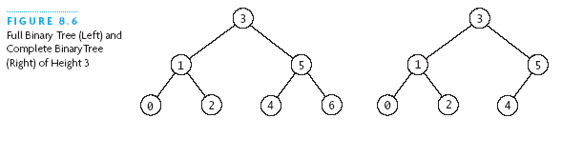
Fullness and Completeness
(In computer science) trees grow from the top down
New values inserted in new leaf nodes
A binary tree is full if all leaves are at the same level
In a full tree, every node has 0 or 2 non-null children
Chapter 8: Trees

Slide 13
Fullness and Completeness (2)
A binary tree is complete if:
  All leaves are at level h or level h-1 (for some h)
  All level h-1 leaves are to the right
Chapter 8: Trees

Slide 14
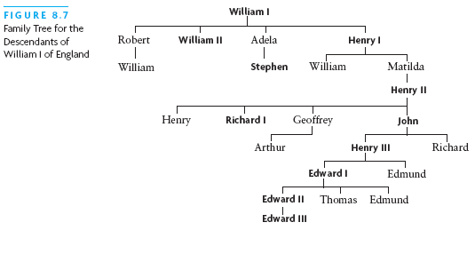
General (Non-Binary) Trees
Nodes can have any number of children
Chapter 8: Trees

Slide 15
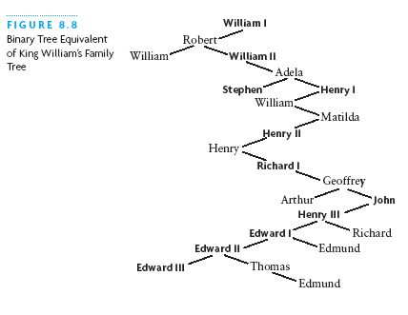
General (Non-Binary) Trees (2)
A general tree can be represented using a binary tree
Left link is to first child
Right link is to next younger sibling
Chapter 8: Trees

Slide 16
Traversals of Binary Trees
Often want iterate over and process nodes of a tree
  Can walk the tree and visit the nodes in order
  This process is called tree traversal
Three kinds of binary tree traversal:
  Preorder
  Inorder
  Postorder
According to order of subtree root w.r.t. its children
Chapter 8: Trees

Slide 17
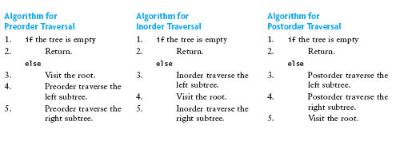
Binary Tree Traversals (2)
Preorder: Visit root, traverse left, traverse right
Inorder: Traverse left, visit root, traverse right
Postorder: Traverse left, traverse right, visit root
Chapter 8: Trees

Slide 18
Visualizing Tree Traversals
Can visualize traversal by imagining a mouse that walks along outside the tree
If mouse keeps the tree on its left, it traces a route called the Euler tour:
Preorder: record node first time mouse is there
Inorder: record after mouse traverses left subtree
Postorder: record node last time mouse is there
Chapter 8: Trees

Slide 19
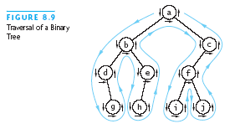
Visualizing Tree Traversals (2)
Preorder:
a, b, d, g, e,
h, c, f, i, j
Chapter 8: Trees

Slide 20
Visualizing Tree Traversals (3)
Inorder:
d, g, b, h, e,
a, i, f, j, c
Chapter 8: Trees

Slide 21
Visualizing Tree Traversals (4)
Postorder:
g, d, h, e, b,
i, j, f, c, a
Chapter 8: Trees

Slide 22
Traversals of Binary Search Trees
Inorder traversal of a binary search tree →
  Nodes are visited in order of increasing data value
Inorder traversal visits in this order: canine, cat, dog, wolf
Chapter 8: Trees

Slide 23
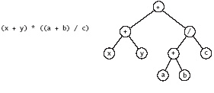
Traversals of Expression Trees
Inorder traversal can insert parentheses where they belong for infix form
Postorder traversal results in postfix form
Prefix traversal results in prefix form
Infix form
Postfix form: x y + a b + c / *
Prefix form: * + x y / + a b c
Chapter 8: Trees

